Slide 1
PAG map
The darker the green,
the higher the cognitive load.

Slide 2
It is our intent that writing across the curriculum will inspire, engage and challenge all pupils, enabling them to develop the skills to effectively communicate their thoughts, ideas and emotions to others. We aim to build the pupils’ stamina for writing, vocabulary knowledge and understanding of grammar, by creating a positive approach to an increasingly wide range of text types (including areas of fiction, non-fiction and poetry).
We recognise the importance of fostering a culture where pupils take pride in their writing; write clearly and accurately; and modify their structure and language choices to suit a variety of audiences, purposes and contexts.
To support pupils in moving towards independent writing at the age-related standard, we provide a wide range of writing stimuli, including the use of film and imagery; modelled, shared and guided writing; peer conferencing; and group discussion. These rich and varied set of learning opportunities support pupils in becoming confident and enthusiastic learners across all areas of the curriculum. At Shrewton Primary School, we want writing to equip our pupils with the necessary tools to communicate effectively and to provide them with the skills to become lifelong creative writers.
Select text type to learn
Set individual targets
Imitate
Inovate
Invent
Select model text
Hot write
Guage progress
Peer edit
What does a writing cycle look like?

Slide 3
Genre | Y1 | Y2 | Y3 | Y4 | Y5 | Y6
Character description | Descriptive sentences | Character and setting description | Character and setting description | Character and setting description | Character and setting description | Character and setting description
Narrative | Short series of sentences linked to a narrative | Sections of a narrative | Narrative with speech | Narrative with speech | Narrative with dialogue | Narrative with dialogue
Diary |  |  | Features of a Diary | Diary | Diary | Diary
Recount | Sentences linked to recount | Recount Organisation and features | Recount | Recount | Recount | Recount
Nonchronological report | Factual sentences linked to a nonchronological report | Nonchronological report Linked sentences about real events | Nonchronological report | Nonchronological report | Nonchronological report | Nonchronological report
Letter |  |  | Features of a letter | Letter | Letter Direct address | Letter Direct address

Slide 4

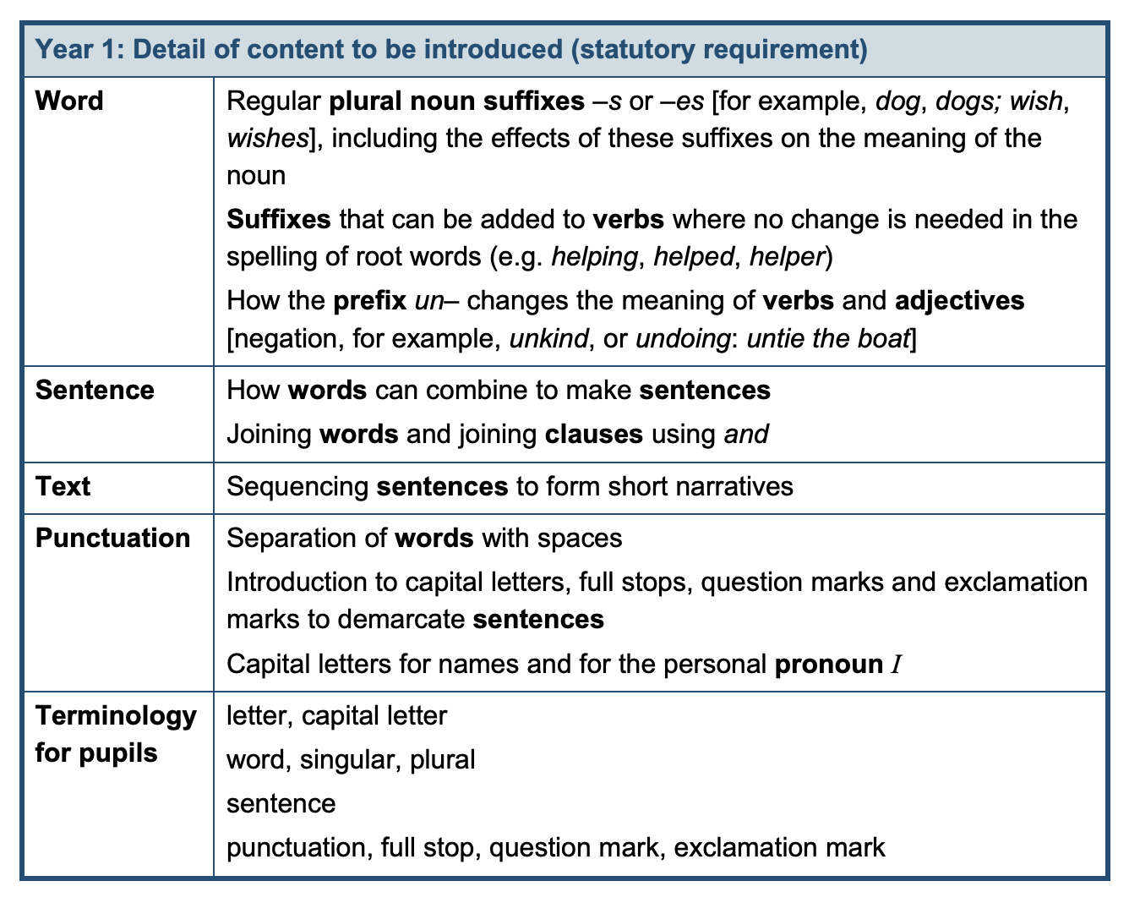
The sentence
Noun phrase | verb phrase.
The sentence
Noun phrase | verb phrase | the when/where/how part.

Slide 5
Year 1 | 1 | 2 | 3 | 4 | 5 | 6
 | Weeks 1-3 character description. 4-6 sentences linked to Narrative | Weeks 1-3 character description. 4-6 Sentences linked to recount | Weeks 1-3 character description. 4-6 sentences linked to Narrative | Weeks 1-3 character description. 4-6 Factual sentences linked to a nonchronological report | Weeks 1-3 character description. 4-6 sentences linked to Narrative | Weeks 1-3 character description. 4-6 Sentences linked to recount
Punctuation and grammar | Assess individual letter formation. Identify errors. Address those found. | Spaces are evident between words. Use of full stops and capital letters to begin sentences are evident mostly. | Accurate use of full stops and capital letters to begin sentences. Conjunction 'and' is used to join two clauses. |  | Conjunction 'and' is used to join two clauses. Capital letters are used to start sentences for the pronoun 'I' and for proper nouns Use ? and ! in some independent pieces of writing accurately. Sentences contain up to 3 clauses. Sentence run-ons are rare.
Composition |  | Evidence of 2-3 short sequenced sentences, (not dictated). | Evidence of 3-4 short sequenced sentences, (not dictated). |  | Children are able to independently compose and write a series of sentences (4-5) to form short narratives.

Slide 6
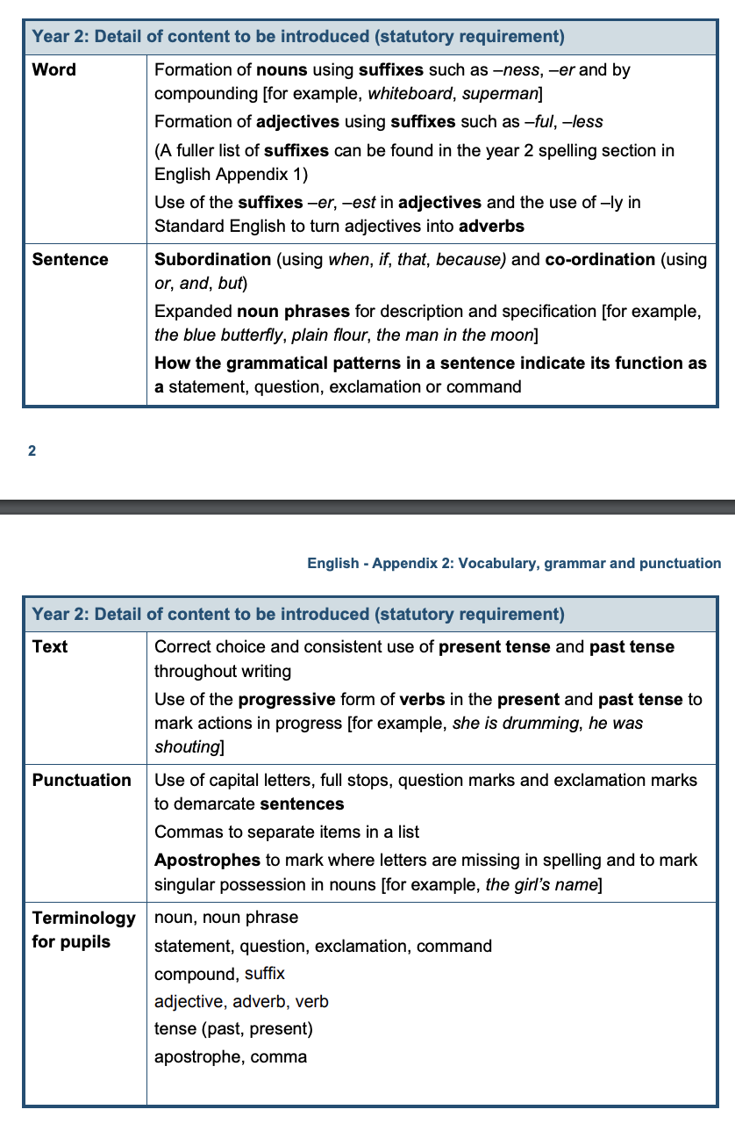

The sentence
Noun phrase | verb phrase.
The sentence
Noun phrase | verb phrase | the when/where/how part.

Slide 7
Year 2 | 1 | 2 | 3 | 4 | 5 | 6
 | Weeks 1-3 character description 4-6 recounts | Weeks 1-3 section of a narrative 4-6 nonchronological report | Weeks 1-3 character description 4-6 recounts | Weeks 1-3 section of a narrative 4-6 nonchronological report | Weeks 1-3 character description 4-6 recounts | Weeks 1-3 section of a narrative 4-6 nonchronological report
Punctuation and grammar | Accurate use of full stops to prevent sentence ‘run ons.’ Capital letters to start sentences, pronoun 'I' and proper nouns. Use conjunction and Use conjunction but Maintain past tense |  | Sentence punctuation: full stops, capitalisation at the start of a sentence and for the pronoun ‘I’ and proper nouns is accurate Conjunction 'and' and ‘but’ to co-ordinate Conjunction ‘because’ and ‘so’ to subordinate Accurate use of ! . ? to terminate sentences Tense (past and present) are maintained across pieces of work. |  | Demarcate most sentences with capital letters and full stops. Question marks when required. Present and past tense mostly correctly and consistently Use co-ordination and Use co-ordination but Use co-ordination or Use subordination when / if / that / because) to join clauses
Composition | Able to write a short coherent piece of narrative 6-8 lines Able to write a series of linked sentences 6-8 sentences about a real event |  | Write about real events and narrative sustaining coherence over the each piece. |  | Write simple, coherent narratives about personal experiences and those of others (real or fictional) Write about real events, recording these simply and clearly

Slide 8

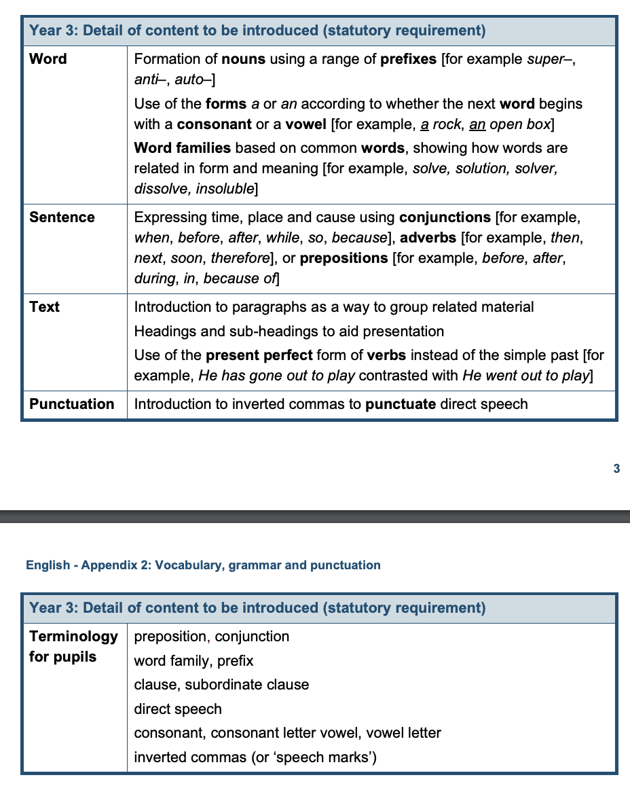
The sentence
Noun phrase | verb phrase | the when/where/how part.
The sentence
The when/where/how part, | noun phrase | verb phrase.
The sentence
Noun phrase | the verb phrase | coordinating conjunction | noun phrase | verb phrase.
The sentence
Noun phrase | verb phrase | subordinating conjunction | verb clause.
The sentence
Subordinating conjunction | verb clause, | noun phrase | verb phrase.

Slide 9
Year 3 | 1 | 2 | 3 | 4 | 5 | 6
 | Weeks 1 character description 2-4 narrative 5-6 recount | Weeks 1 character description 2-4 narrative 5-6 Nonchronological report | Weeks 1 character description 2-4 narrative 5-6 features of a diary | Weeks 1 character description 2-4 narrative 5-6 features of a letter | Weeks 1 character description 2-4 narrative 5-6 features of a diary | Weeks 1 character description 2-4 narrative 5-6 features of a letter
Punctuation and grammar | Using the full range of punctuation from Key Stage 1 correctly (? . ! capitalisation to begin new sentences, pronoun ‘I’ and for proper nouns. Possessive apostrophe for singular possession Apostrophes to mark contractions Commas to separate items in a list Use a and an correctly |  | Using the full range of punctuation from Key Stage 1 correctly (? . ! capitalisation to begin new sentences, pronoun ‘I’ and for proper nouns. To use taught verb tenses consistently including present perfect and past progressive Using inverted commas to demarcate direct speech. |  | Using the full range of punctuation from Key Stage 1 correctly (? . ! capitalisation to begin new sentences, pronoun ‘I’ and for proper nouns. To use taught verb tenses consistently including present perfect and past progressive Using inverted commas to demarcate direct speech.
Composition | Can write simple settings and character descriptions and narrative that follows a plot use simple organisational devices such as heading and subheadings Using simple expanded noun phrases within settings and character descriptions. Use co-ordinating and subordinating conjunctions when if that because to join clauses |  | Use paragraphs to group related sentences Write for a range of real purposes and audiences, beginning to develop an awareness of appropriate language and form Use conjunctions, adverbs and prepositions to express place, time and cause (when, before, after, next, soon) Use introductions/openings and conclusions/endings |  | Use a wider range of subordinating conjunctions that go beyond when, if, that, because (e.g. whilst, although, since) Use paragraphs to group related sentences Write for a range of real purposes and audiences, beginning to develop an awareness of appropriate language and form Use conjunctions, adverbs and prepositions to express place, time and cause (when, before, after, next, soon) Use introductions/openings and conclusions/endings

Slide 10
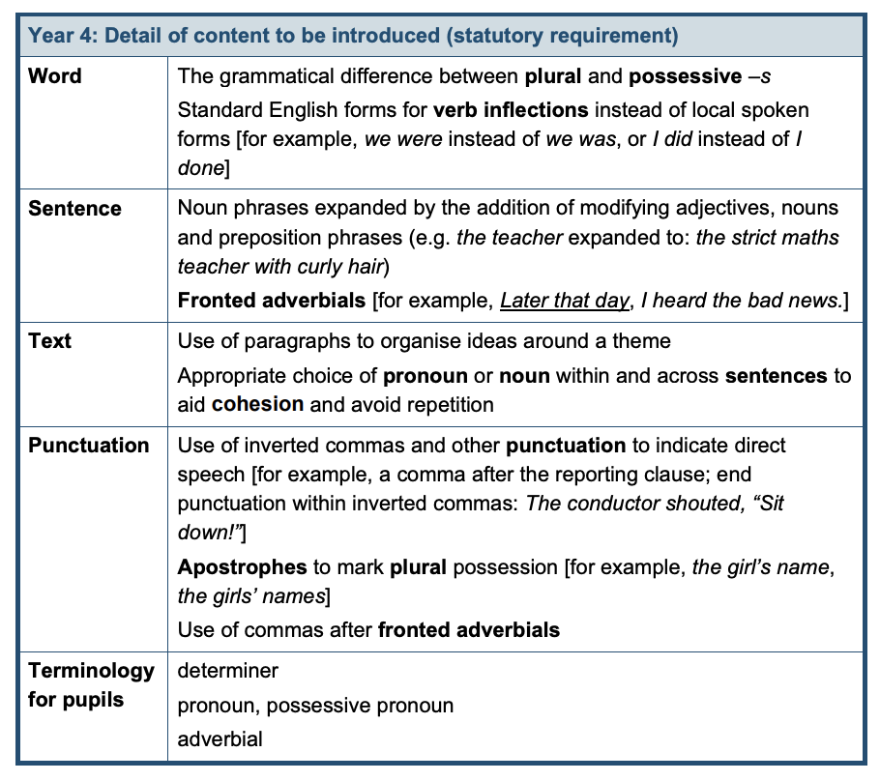
Year 4

Slide 11
Year 4
The sentence
Noun phrase | verb phrase.
The sentence
Noun phrase | verb phrase | subordinating conjunction | verb clause.
The sentence
Noun phrase | verb phrase | the when/where/how part.
The sentence
Subordinating conjunction | verb clause, | noun phrase | verb phrase.
The sentence
The when/where/how part, | noun phrase | verb phrase.
The sentence
Noun phrase, | relative clause, | verb phrase.
The sentence
Noun phrase | the verb phrase | coordinating conjunction | noun phrase | verb phrase.

Slide 12
Year 4 | 1 | 2 | 3 | 4 | 5 | 6
 | Weeks 1 character description 2-4 narrative 5-6 recount | Weeks 1 character description 2-4 narrative 5-6 Nonchronological report | Weeks 1 character description 2-4 narrative 5-6 diary | Weeks 1 character description 2-4 narrative 5-6 letter | Weeks 1 character description 2-4 narrative 5-6 diary | Weeks 1 character description 2-4 narrative 5-6 letter
Punctuation and grammar | Using ? . ! capitalisation to begin new sentences, pronoun ‘I’ and for proper nouns. Possessive apostrophe for singular possession Apostrophes to mark contractions Commas to separate items in a list Use a and an correctly Organise paragraphs around a theme, starting a new one when appropriate (change of time, setting, theme). |  | Using ? . ! capitalisation to begin new sentences, pronoun ‘I’ and for proper nouns. Possessive apostrophe for singular possession Apostrophes to mark contractions Commas to separate items in a list Use a and an correctly Present perfect and past progressive Using inverted commas to demarcate direct speech even when the reporting verb splits the speech. Comma to demarcate a fronted adverbial Plurals and apostrophe for plural and singular possession Use taught verb tenses consistently |  | Using ? . ! capitalisation to begin new sentences, pronoun ‘I’ and for proper nouns. Possessive apostrophe for singular possession Apostrophes to mark contractions Commas to separate items in a list Use a and an correctly Present perfect and past progressive Comma to demarcate a fronted adverbial Using inverted commas to demarcate direct speech even when the reporting verb splits the speech. Plurals and apostrophe for plural and singular possession Use taught verb tenses consistently
Composition | Can write simple settings and character descriptions and narrative that follows a plot use simple organisational devices such as heading and subheadings Using simple expanded noun phrases within settings and character descriptions. Use co-ordinating and subordinating conjunctions when if that because to join clauses |  | Use paragraphs to group related sentences Write for a range of real purposes and audiences, beginning to develop an awareness of appropriate language and form Use conjunctions, adverbs and prepositions to express place, time and cause (when, before, after, next, soon) Use introductions/openings and conclusions/endings |  | Use a subordinating clause at the start and end of sentences Write with an awareness of appropriate language and form, choosing appropriate devices to add interest well paced plot and characterisation including actions and speech. To use appropriate structural and grammatical features in both fiction and non-fiction texts Use subordinating conjunctions when, if, that, because , whilst, although, since,

Slide 13
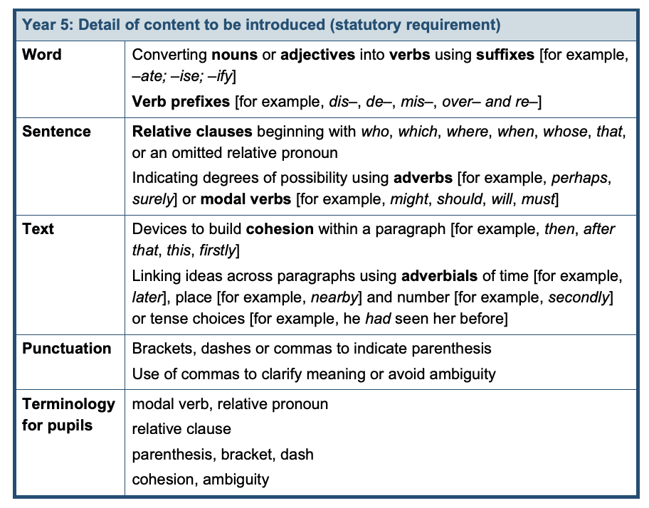
Year 5

Slide 14
Year 5
The sentence
Noun phrase | verb phrase.
The sentence
Noun phrase | verb phrase | subordinating conjunction | verb clause.
The sentence
Noun phrase | verb phrase | the when/where/how part.
The sentence
Subordinating conjunction | verb clause, | noun phrase | verb phrase.
The sentence
The when/where/how part, | noun phrase | verb phrase.
The sentence
Noun phrase, | relative clause, | verb phrase.
The sentence
Noun phrase | the verb phrase | coordinating conjunction | noun phrase | verb phrase.

Slide 15
Year 5 | 1 | 2 | 3 | 4 | 5 | 6
 | Weeks 1 character description 2-4 narrative 5-6 recount | Weeks 1 character description 2-4 narrative 5-6 Nonchronological report | Weeks 1 character description 2-4 narrative 5-6 diary | Weeks 1 character description 2-4 narrative 5-6 letter | Weeks 1 character description 2-4 narrative 5-6 diary | Weeks 1 character description 2-4 narrative 5-6 letter
Punctuation and grammar | Use apostrophes including plurals; comma for a fronted adverbial and all other taught punctuation. Use a and an correctly Punctuate speech Use modal verbs to show possibility Organise paragraphs around a theme, starting a new one when appropriate (change of time, setting, theme). |  | Use taught verb tenses consistently including present (perfect), past progressive Punctuate dialogue Use commas to demarcate clauses within a multi clause sentence To use relative clauses, correctly punctuated Use brackets, dashes and commas for parenthesis |  | Use taught verb tenses consistently including present (perfect), past progressive Punctuate dialogue Use commas to demarcate clauses within a multi clause sentence To use relative clauses, correctly punctuated Use brackets, dashes and commas for parenthesis
Composition | Use simple and multi (up to 3) clause sentences incorporating conjunctions to develop ideas. Develop cohesion across sentences and sections of text (e.g. by choosing nouns or pronouns appropriately to avoid repetition). Using paragraphs, headings and sub-headings to organise ideas and material across the text |  | Use simple and multi (up to 3) clause sentences incorporating conjunctions to develop ideas. Write with an awareness of appropriate language and form linked to text purpose and the level of formality required In developed narratives, incorporate a well-paced plot and characterisation including actions and dialogue to convey characters |  | Use simple and multi (up to 3) clause sentences incorporating conjunctions to develop ideas. Write with an awareness of appropriate language and form linked to text purpose and the level of formality required In developed narratives, incorporate a well-paced plot and characterisation including actions and dialogue to convey characters

Slide 16
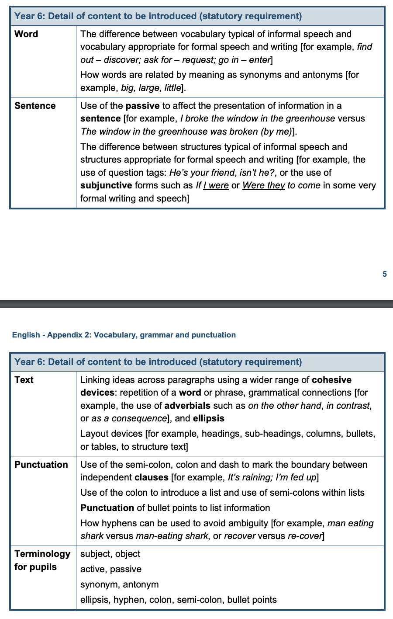
Year 6

Slide 17
Year 6
The sentence
Noun phrase | verb phrase.
The sentence
Noun phrase | verb phrase | subordinating conjunction | verb clause.
The sentence
Noun phrase | verb phrase | the when/where/how part.
The sentence
Subordinating conjunction | verb clause, | noun phrase | verb phrase.
The sentence
The when/where/how part, | noun phrase | verb phrase.
The sentence
Noun phrase, | relative clause, | verb phrase.
The sentence
Noun phrase | the verb phrase | coordinating conjunction | noun phrase | verb phrase.

Slide 18
Year 6 | 1 | 2 | 3 | 4 | 5 | 6
 | Weeks 1 character description 2-4 narrative 5-6 recount | Weeks 1 character description 2-4 narrative 5-6 Nonchronological report | Weeks 1-2 full narrative 3-4 diary 5-6 Nonchronological report | Weeks 1-2 narrative 3-4 letter direct address 5-6 diary | Weeks 1-2 character description 3-4 recount 5-6 nonchronological report | Edit and review
Punctuation and grammar | Use the range of punctuation taught at key stage 2 so far mostly correctly (e.g. basic sentence punctuation; apostrophes including plurals; inverted commas and other punctuation to indicate direct speech, comma for a fronted adverbial and multiclause sentences, dashes commas and brackets for parenthesis). To use taught verb tenses consistently including present (perfect), past progressive Use colons and semi colons to demarcate the boundaries between independent clauses. Punctuate dialogue Use commas to demarcate clauses within a multi clause sentence |  | Use the range of punctuation taught at key stage 2 so far mostly correctly (e.g. basic sentence punctuation; apostrophes including plurals; inverted commas and other punctuation to indicate direct speech, comma for a fronted adverbial and multiclause sentences, dashes commas and brackets for parenthesis). To use taught verb tenses consistently including present (perfect), past progressive Use colons and semi colons to demarcate the boundaries between independent clauses Punctuate dialogue Use commas to demarcate clauses within a multi clause sentence |  | Use the range of punctuation taught at key stage 2 so far mostly correctly (e.g. basic sentence punctuation; apostrophes including plurals; inverted commas and other punctuation to indicate direct speech, comma for a fronted adverbial and multiclause sentences, dashes commas and brackets for parenthesis). Use verb tenses consistently and correctly throughout their writing Use the range of punctuation taught at key stage 2 mostly correctly^ (e.g. inverted commas and other punctuation to indicate direct speech)
Composition | Use simple and multi (up to 3) clause sentences incorporating conjunctions to develop ideas. Write with an awareness of -appropriate language and form - linked to text purpose (e.g. bullet points) -the level of formality required (e.g. informal writing drawing on contracted words and speech like sentence structures) Incorporate a well-paced plot and characterisation including actions and dialogue to convey characters |  | Understand how to use the passive voice and the subjunctive form to increase the formality of writing. |  | Write effectively for a range of purposes and audiences, selecting language that shows good awareness of the reader In narratives, describe settings, characters and atmosphere Integrate dialogue in narratives to convey character and advance the action Select vocabulary and grammatical structures that reflect what the writing requires, doing this mostly appropriately Use a range of devices to build cohesion

Slide 19





Do now activity | Something onscreen that is immediately accessible for all so work begins within the transition.
3+ SPAG questions | Make these pertinent to what you have done or are about to do so you activate prior knowledge and build on it.
I do | Direct teaching opportunity. Here you model the small steps required to lead to success.
We do | Here you can AFL who has understood and who requires further teaching. Having a small question under your LO can act as an entry ticket you can live mark.
You do | Make clear exactly what students are to do and what you expect it to look like. Chilli challenges provides challenge and support.
Structured reflection | Reflecting on the learning in the lesson as a class. Students sharing good examples allows others magpie. (Always give the listeners an active part to play, “listen, I’ll be asking you which subordinating conjunction they used.”
Marking and feedback Green successful examples of hitting the LO. Pink errorful learning so students can purple polish. Pink actionable next steps.

Slide 20
Alan Peat Exciting sentences by Year group
 | Sentences for revision | Sentences for teaching
YR |  | Simile – like a….
Y1 | like a…. | 2A as a … like a…. Boys (summer term MA)
Y2 | 2A as a … like a…. Boys (summer term MA) | Double ly Emotion word, (comma)
Y3 | as a … like a…. Double ly Emotion word, (comma) | 3 –ed sentences verb, person 2 pairs
Y4 | 3 –ed sentences verb, person 2 pairs Emotion word, (comma) | -ing, -ed Ad, some , ad Personification of weather
Y5 | (all of above!!!!) | De:de One word phrase : definition Some; others Noun, which , where, who 3 bad – (dash) question? P.C. sentences Outside (inside)
Y6 | De:de One word phrase : definition Some; others Noun, which , where, who 3 bad – (dash) question? P.C. sentences Outside (inside) | Imagine 3 x examples The more, the more If, if, if then Last word, first word (yoked)

